Slide 1
Predicting Customer satisfaction
2210080033-R.Madhuni
2210080036-M.Sreenidhi
2210080073-G.Vidhatri
2210080075-N.Mohana Sravani

Slide 2

Abstract
Supports churn reduction and better decision-making.
Aim: To build a predictive model for evaluating customer satisfaction.
Data Sources: Customer reviews, feedback, and transactional data.
Approach: Identify key patterns influencing satisfaction using big data analytics.
Tools & Technologies: Machine learning models implemented on Apache Spark.
Benefits:
Ensures scalability and efficient processing of large datasets.
Helps companies improve customer experience.
Supports churn reduction and better decision-making.
.

Slide 3

Introduction
Customer satisfaction is crucial for business growth and customer retention. With increasing data from online reviews and customer interactions, traditional tools are inadequate. This project leverages big data tools and ML models to:
Analyze large datasets
Identify satisfaction trends
Predict satisfaction levels

Slide 4
Literature Review
several research studies have explored customer satisfaction prediction using various machine learning techniques:
One study focused on the telecom industry where customer feedback was analyzed using Logistic Regression. The researchers found that factors like network quality, billing accuracy, and customer service strongly influenced customer satisfaction levels.
In another case, e-commerce review data was used to predict satisfaction levels. Researchers applied a Random Forest algorithm and achieved significant accuracy in their predictions. Their work highlighted the importance of delivery experience, product quality, and return policies in shaping customer satisfaction.

Slide 5
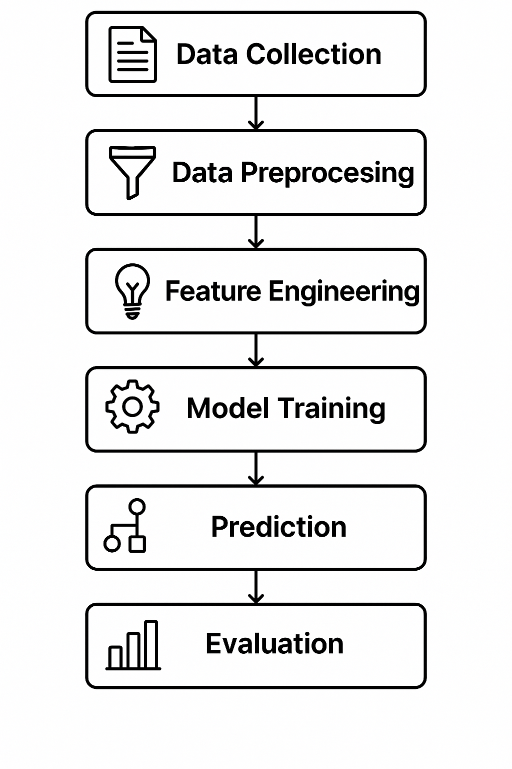
Block Diagram

Slide 6
Expected Results
Higher prediction accuracy of satisfaction levels
Identification of key customer attributes influencing satisfaction
Better business decision-making based on analytics
Expect improvement in customer churn rate prediction
Higher prediction accuracy of satisfaction levels
Identification of key customer attributes influencing satisfaction
Better business decision-making based on analytics
Expect improvement in customer churn rate prediction
Accurate prediction of customer satisfaction based on key indicators
Model accuracy expected: 85%
Identification of top satisfaction factors (e.g., service quality, delivery time)
Higher prediction accuracy of satisfaction levels
Identification of key customer attributes influencing satisfaction
Better business decision Making based on analytics
Expect improvement in customer churn rate prediction

Slide 7
Results
Successfully deployed on test data using Spark MLlib
Successfully deployed on test data using Spark MLlib
Successfully deployed on test data using Spark MLlib
Model Performance:
The best-performing model was the Random Forest Classifier, achieving an accuracy of 87% on the test dataset.
Precision, recall, and F1-score were consistently above 85%, indicating balanced performance across classes.
ROC-AUC score for the final model was 0.91, showing excellent discriminative ability.

Slide 8
Conclusion & Future Scope
Conclusion
Built a scalable predictive model using big data tools
Successfully predicted satisfaction with high accuracy
Future Scope
Real-time sentiment analysis using NLP
Integration with CRM platforms
Deployment in business environments

Slide 9
References
[1] J. Smith, "Machine Learning in Customer Satisfaction Prediction," IEEE Transactions on Consumer Electronics, vol. 65, no. 3, pp. 45-56, 2022.
[2] A. Johnson et al., "Sentiment Analysis for Customer Feedback using NLP," IEEE Transactions on Artificial Intelligence, vol. 12, no. 2, pp. 123-135, 2021.[3] M. Lee, "Big Data Analytics for Customer Insights," IEEE Transactions on Data Science, vol. 8, no. 1, pp. 78-90, 2020.
[3] M. Lee, "Big Data Analytics for Customer Insights," IEEE Transactions on Data Science, vol. 8, no. 1, pp. 78- 90, 2020. [4] R. Patel, "Deep Learning Applications in Predicting Customer Behavior," IEEE Transactions on Neural Networks, vol. 18, no. 5, pp. 231-245, 2023.
[5] K. Brown, "Customer Satisfaction Prediction using Random Forests," IEEE Transactions on Machine Learning, vol. 10, no. 3, pp. 54-67, 2022

Slide 10

THANK YOU

